Slide 1
Diversity in Tourism

Slide 2
Diversity training for tourism
The story behind the project – Erasmus +

Slide 3
Working together well, as a group
What do you need to work and discuss diversity with serenity?
What do we need as trainers to run our sessions well?

Slide 4
Who are you? - Discussions
What is your name ?
Where were you born?
What is the furthest you have travelled?
What is a place you would love to visit?
What is your job in the organization ?

Slide 5
Working in a context of high-diversity
To you, what is diversity?
What does it mean to work in a diverse environment?
Notes:
From the beginning of their careers

Slide 6
Working in a context of diversity
A situation that surprised you
Something you’ve learned from working in such an environment
A situation that led to tension / conflict
Notes:
From the beginning of their careers

Slide 7
BREAK

Slide 8
Diversity leads to the notion of Group belonging (social identity)
Diversity leads to Group belonging = “social identity”
Groups create norms and habits that we call culture

Slide 9
There are many types of cultures that meet at the workplace
Origins
Organizational / Company culture
Social culture / Classes
Jobs (“occupational culture”)
Places we live
And many more…

Slide 10
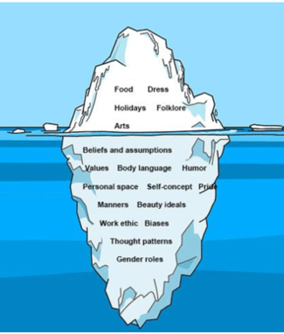
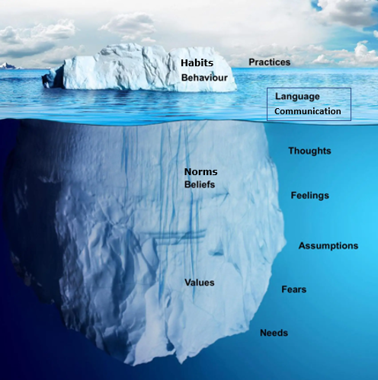
What elements create a culture?

Slide 11
Groups’ diversity
Are you typical ?

Slide 12
Analyzing tensions
Individual
Reaction
Culture
Context
Why is culture so easy to blame for tensions ?

Slide 13
Cultural elements at stakes at the workplace
Time management
Sense of urgency
Limits
Uncertainty and need for structure
Expectations from work
Relation to hierarchy and rules
Managing and expressing opposition / communication styles
Expectations from colleagues in work actions
Expectations from colleagues in relationships

Slide 14
A focus on Communication styles
What differences did you experience in ways customers or colleagues communicate with you ?
How does the style of communication affects you ?

Slide 15
A coding and encoding process

Slide 16
What is
behind communication
What people hear
Para-verbal communication
Message going through
What people see and feel
Non-verbal communication
What you say
Verbal communication

Slide 17
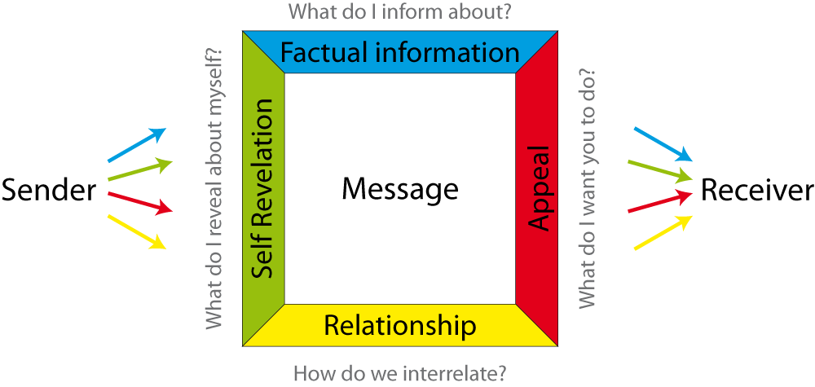
4 Dimensions in Communication

Slide 18
Cultural components in communication
It works at every level of diversity
It is easier to speak to someone who is similar to yourself
➔ What can be done to facilitate communication across cultures ?

Slide 19
Group work - discussion
What can we do as an organization to collaborate better within diversity?

Slide 20
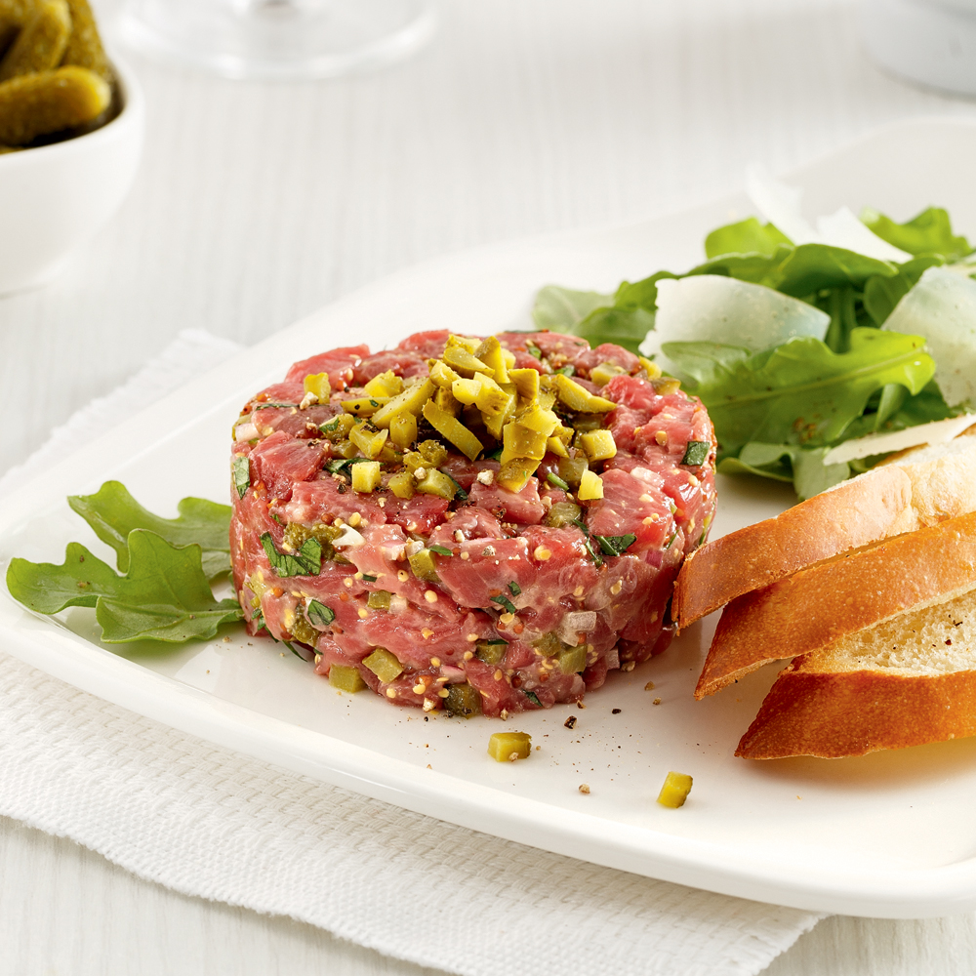
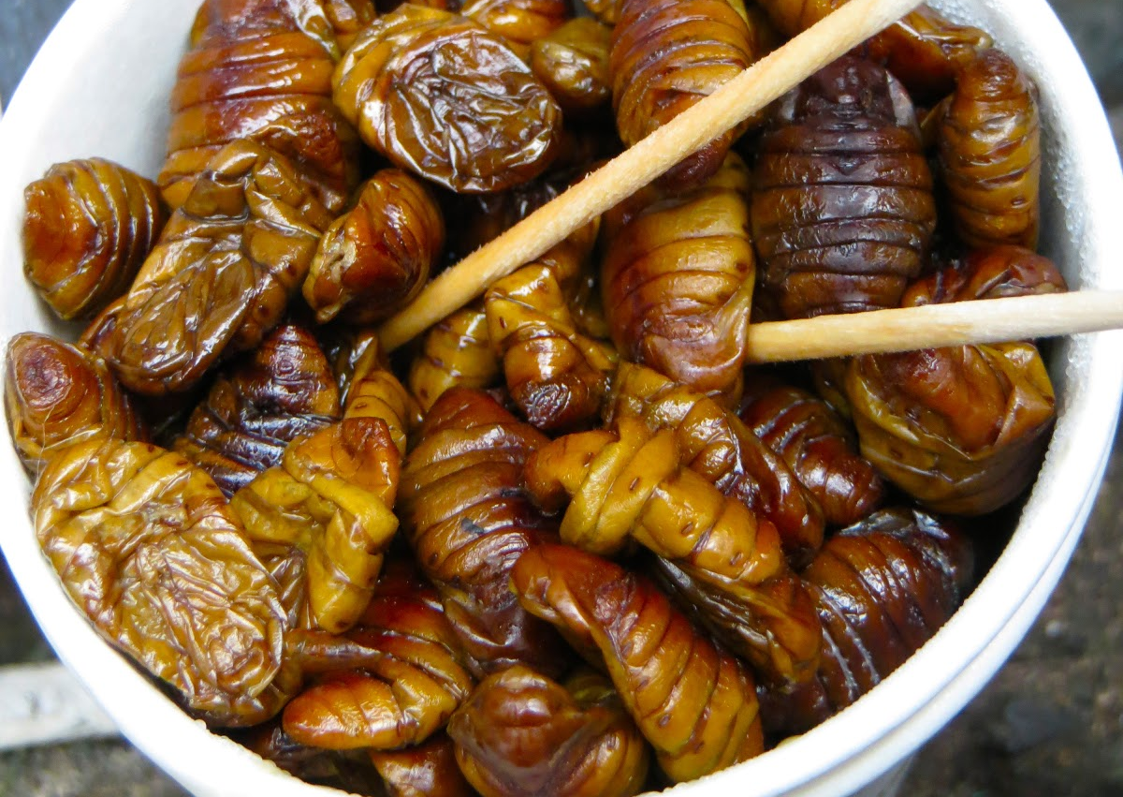
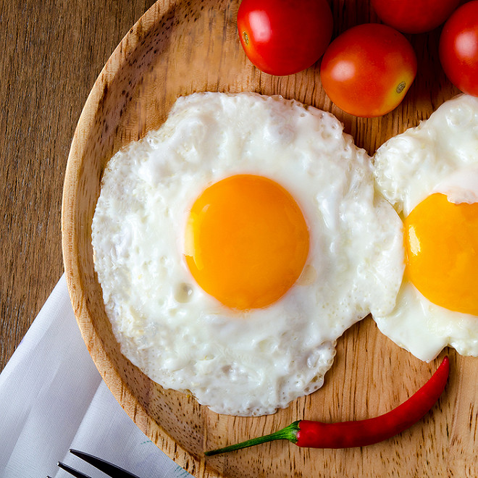
LUNCH

Slide 21
Diversity training Day 2
Dublin, 1. November 2022

Slide 22
Thoughts from yesterday
Notes:
Ask the quite ones

Slide 23
Identity / Identities
Identity is what we are or what we believe we are
Each and everyone has many identities
Notes:
How many identities do you have? Trainer shares elements of his/her identity (man, woman, Icelander, Christian) - both primary and secondary, with no distinction. Give very simple, concrete examples (gender, parent, one big hobbie). Think about it before, don’t go to complexe Who is like me ?

Slide 24
Identity and identity circle exercise
What are your identities, and what are the ones that matter most ?
Notes:
How many identities do you have? Trainer shares elements of his/her identity (man, woman, Icelander, Christian) - both primary and secondary, with no distinction. Give very simple, concrete examples (gender, parent, one big hobbie). Think about it before, don’t go to complexe Who is like me ?

Slide 25
Discussions
Why did you choose these elements ? Why are they important ?
Have some of them changed over time ? What made your identities change ?
Notes:
Ask participants to write their primary identities in the middle
Share and discuss in pairs for 5 minutes : why did they choose these elements as primary identity ? Why are these identities important ?

Slide 26
Questions
Do you feel you have double identities ?
Do you feel you are a very different person in one group and in another group ?
How would you feel if someone attacked an identity that is important to you?

Slide 27
Identity and identity circle exercise
What kind of identities exit ?
Notes:
How many identities do you have? Trainer shares elements of his/her identity (man, woman, Icelander, Christian) - both primary and secondary, with no distinction. Give very simple, concrete examples (gender, parent, one big hobbie). Think about it before, don’t go to complexe Who is like me ?

Slide 28
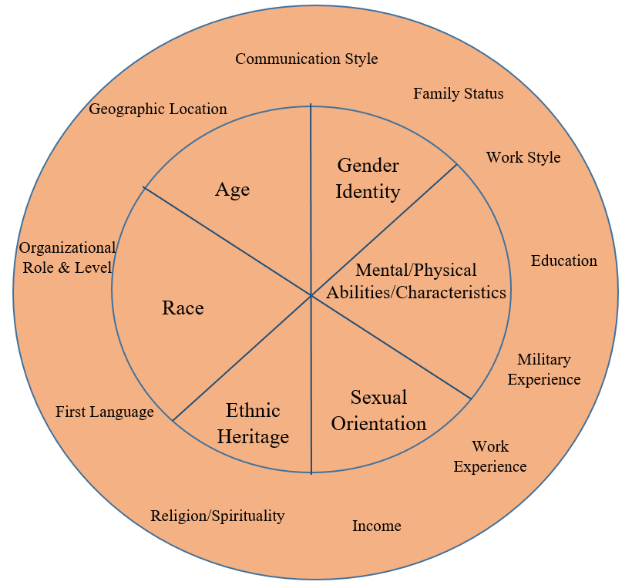
Identity circle

Slide 29
BREAK

Slide 30
Guessing game
Find 3 statements about yourself – 2 true 1 false
Try to make it hard for others to guess which is which !
Try to guess from others
Notes:
Main learning from the group talk?
Shifting from talking about oneself – what did you learn from listening at the others

Slide 31
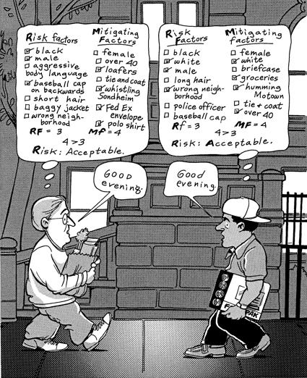
Categorizing people
Notes:
Main learning from the group talk?
Shifting from talking about oneself – what did you learn from listening at the others

Slide 32
Why group belonging and social identities ?
It is a paradox
We all have a need to belong to groups
We look for and favor similarities

Slide 33
Group belonging (social identity –ingroup/outgroup)
Ingroup- outgroup
Natural, rational and sometimes moral classifications
Classifications of ourselves and others
Not always a bad thing!
Ingroup bias, or tendency to favor your own group at the expense of others, is powerful, even when it´s totally irrational
Groups can start to divide into “us vs. them” on things that are even meaningless (in the beginning)
Same color of sock, same brand of sneakers

Slide 34
Group belonging (social identity)
“Are you same enough to be my equal?”

Slide 35
https://www.youtube.com/watch?v=jD8tjhVO1Tc

Slide 36
Generalization, stereotypes & discrimination
Cultural generalizations is the kind of hypothesis we expect to encounter when meeting a culture
It becomes a stereotype when all members are categorized as having the same characteristics
Stereotypes may be positive and negative, and they may be about many things. But they lead to intentional or unintentional discrimination
Notes:
Remember to say everyone has stereotypes

Slide 37
Discrimination
Do you feel or have you ever felt discriminated against for belonging to a specific group?
What are the groups that are most likely to be discriminated against ?
What kind of discrimination do you think these group can face? In their daily life? At your workplace?
Notes:
Whithin the workplace, what can be subject to discrimination ? - Ethnicity - National cultures - Gender, - Religious belonging, - LGBTQ - Disability / Ableism /mental ability - Socioeconomic status / class - Age - Old staff / New staff
Primary identities

Slide 38
Notion of minority
Notes:
Exlain Minority + power

Slide 39
We are all in the same storm, but not in the same boat
https://www.youtube.com/watch?v=4K5fbQ1-zps
Notes:
Whithin the workplace, what can be subject to discrimination ? - Ethnicity - National cultures - Gender, - Religious belonging, - LGBTQ - Disability / Ableism /mental ability - Socioeconomic status / class - Age - Old staff / New staff
Primary identities

Slide 40
Group work / group discussion
What do you feel privilege about?
Who are you most likely to discriminate against?

Slide 41
Group work / group discussion
Who are we most likely to discriminate against within our workplace?
What could do to be an even more inclusive organization ?

Slide 42
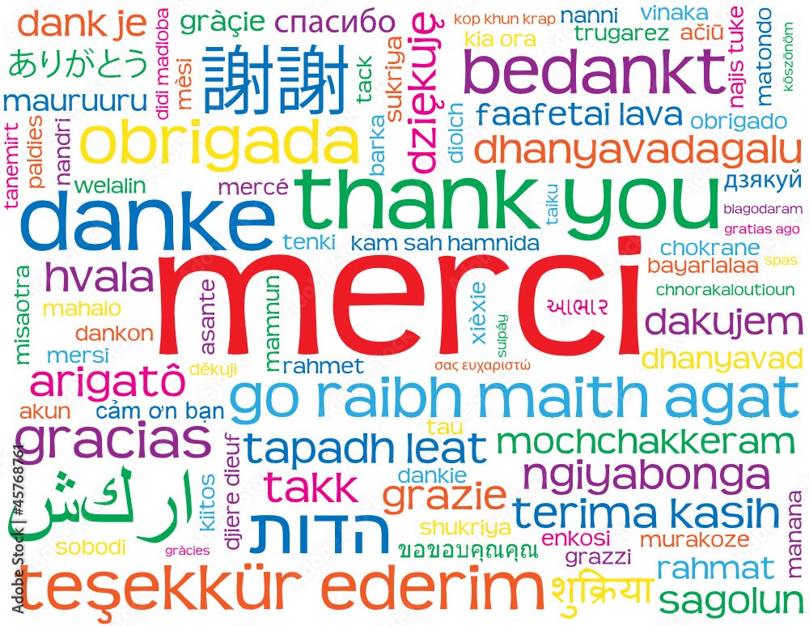

Slide 43
ADDITIONAL MODULES

Slide 44
On-boarding process: Integrating a diverse team
How can “work in a diverse context” be included to the onboarding process ?
What are your challenges you face to integration a new person ?

Slide 45
Groups within the organization
What are the groups within your organization ?
What image do these groups have ?
Where do these groups meet ?

Slide 46
Subjective Mapping of the organization
Who do you work with ? Which groups ?
What are your needs and expectations from them ?
What image do you have of them ? What would you like to know ?

